Slide 1
cif2lammps validation
Ryther Anderson

Slide 2
UFF/UFF4MOF validation
Methods
Per Matthew Addicoat (author of UFF4MOF) the best way to check UFF/UFF4MOF implementations is comparison with GULP as the original UFF4MOF implementation was in GULP. I have addressed this in two ways. First, I directly use the atom-type parameters found in GULP’s uff4mof.lib in cif2lammps (just converted to a Python dictionary). Second, I compared GULP energies to LAMMPS energies for nine metal clusters and nine organic molecules. Given that UFF and UFF4MOF are the same for organic molecules this also serves as a validation for UFF.

Slide 3
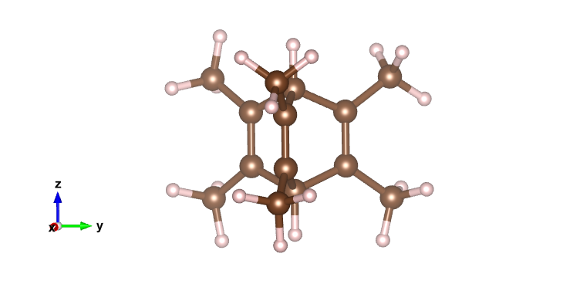
UFF4MOF validation
Double bond with incorrect bond order in GULP
These two points are from GULP using an incorrect bond order for bicyclooctane-derived molecules. The double bond should have bond order 2.0, but GULP uses 1.0 for some reason.
Energy comparison
Energies are the same for GULP and LAMMPS (except for the case noted above)

